Slide 1
GraphQl Api
Spring boot

Slide 2
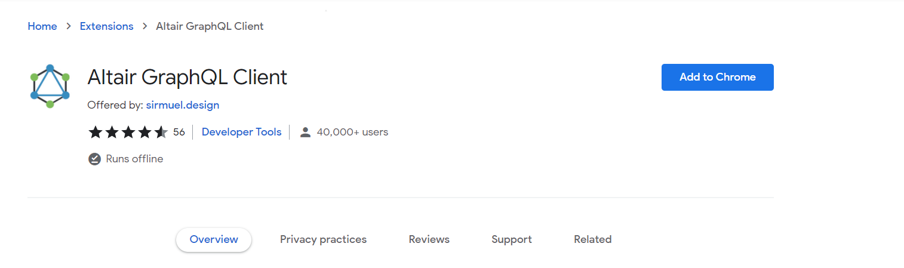
Chrome WEB STORE: Altair GraphQL CLIENT
Install in chrome web the ‘Altair GraphQL Client’:

Slide 3
What is GraphQL?
Stands for graph query Language.
Developed by Facebook.
Its open source data query and manipulation language for API.
Like SQL here we use query to fetch the data.
You have flexibility which data to fetch.
Query to fetch the data and Mutation to alter the data.
Like REST APIs you can use GraphQL with different programing languages like: Java, Python, Php, Ruby, …

Slide 4
What is GraphQL query ?
Used to fetch the data.
You can compare its with GET REST APIS.
When working with java, you using GraphQLQueryResolver interface.

Slide 5
What is GraphQL Mutation ?
Used to alter the data: Create, Update or delete.
You can compare its with POST, PUT REST APIS.
When working with java, you using GraphQLMutationResolver interface.

Slide 6
What is GraphQL Schema ?
Provides flexibility to consumers that which attributes they want in the response.
It's found in .graphqls file extension
Define which attributes are there in your class with data type.
Contract between consumer and provider on how to get and alter the data for the application:
If not write the field in the schema, the consumer can’t view its.
Schema is collection of GraphQL types.
Query and Mutation are root types in the schema.

Slide 7
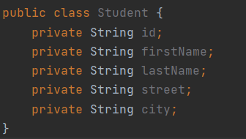
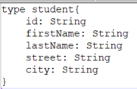

What is GraphQL Schema - Example
Class in java:
Schema with type of Student:
Don’t expose city to consumer:

Slide 8
GraphQL Vs REST api
Rest API | GraphQl
X | V | Attributes flexibility
V | X | Over and Under
Different http methods and separate endpoint for each API | Have Query and Mutation and only one method | Endpoint and methods
X | V | Need Schema file
Notes:
Over -> exists 50 fields in the response but we need only 5 field.
Under -> two Rest api:
one get first name by student id.
the second get the last name by student id.
if you want first name and last by student id?:
- in rest Api you need to add more api.
- in GraphQl you need only add the field in the query when you request the data.

Slide 9
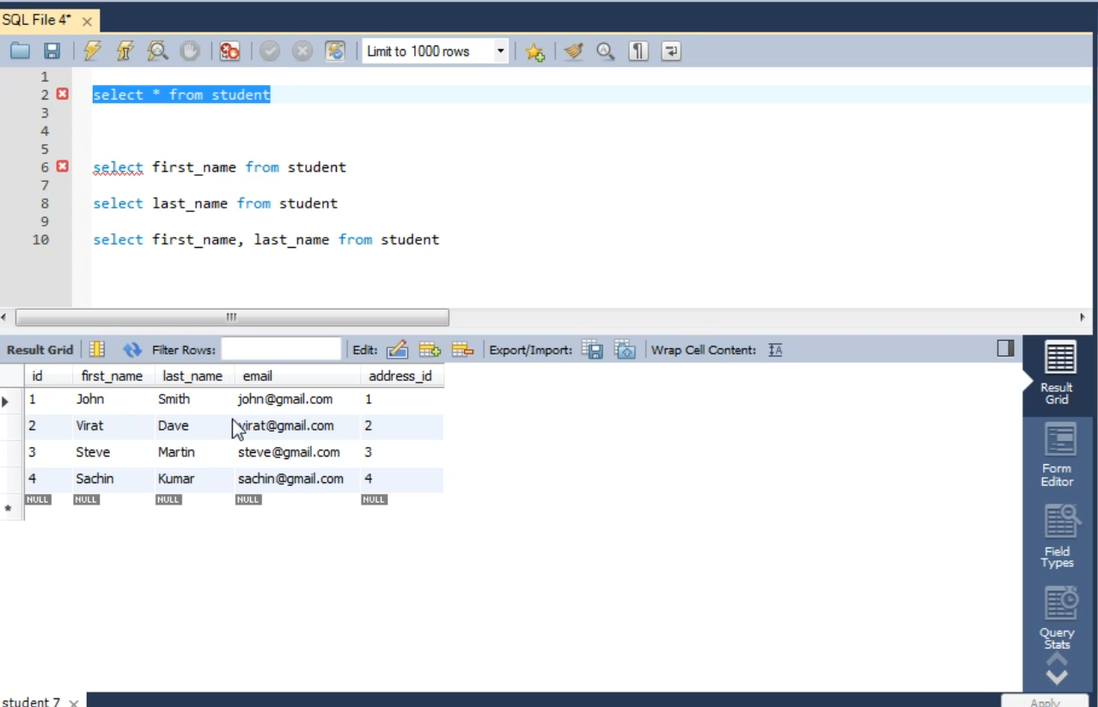
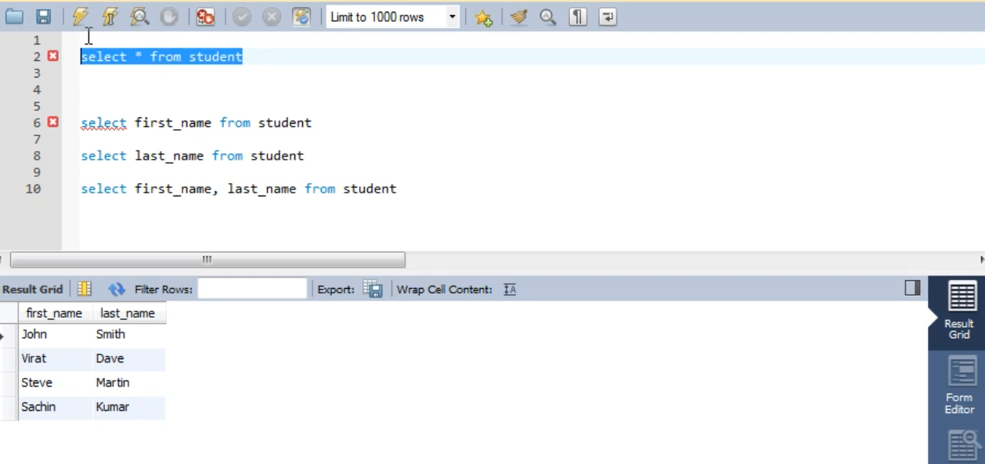
GraphQL and REST api compared to SQL
Rest API
GraphQl API

Slide 10
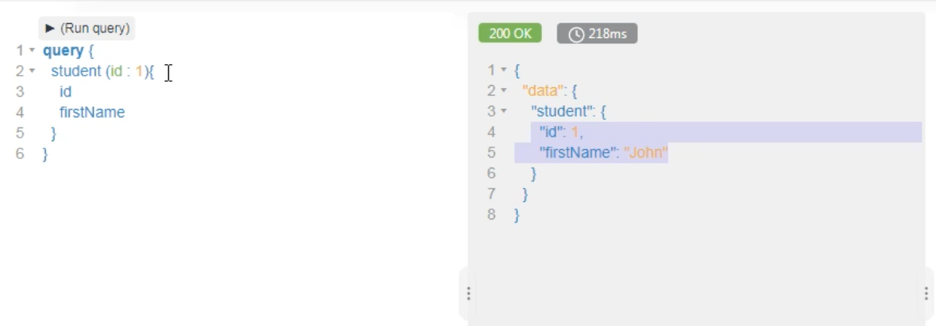
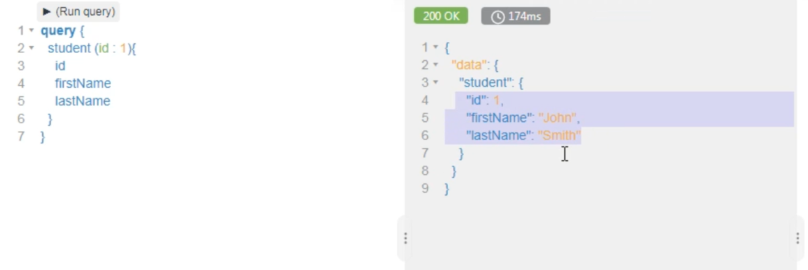
Example of QUERY USING
Notes:
Show the flexibility

Slide 11
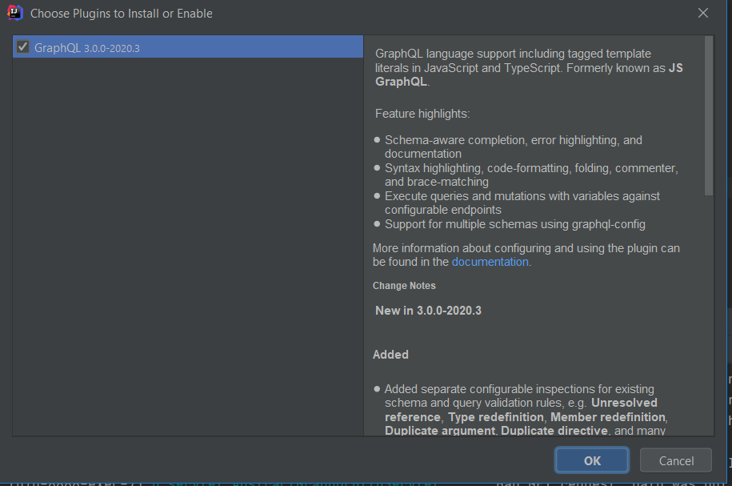
Plugin in IntelliJ

Slide 12
Code
Original controller of rest API.
Dependencies in Gradle.
Schema.
Query.
Resolver.
Filter
Mutation.
Post
UI : http://localhost:8888/graphiql
Annotation.

Slide 13
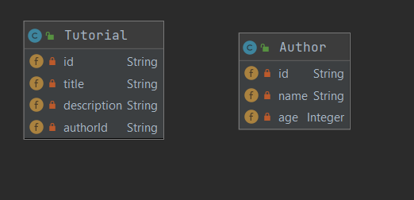
Node And edge in Graphql
Edge
Tutorial node
Author node

Slide 14
Change default UrlS OF gRPAHql
graphql.mapping=/app-ui (by default graphiql)
graphql.servlet.mapping: /apis/graphql (by default graphql)

Slide 15
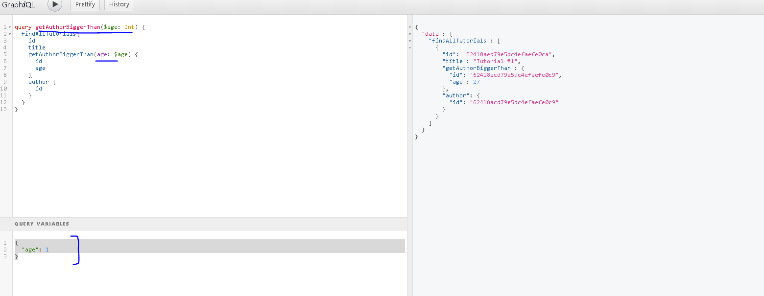
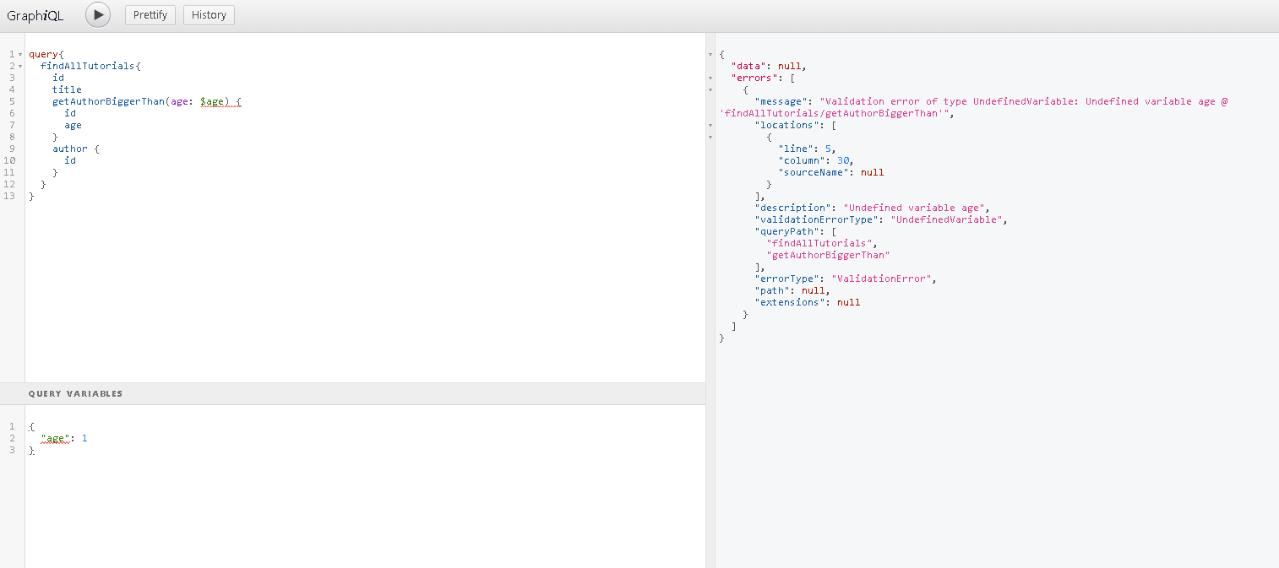
Graphql Variabels

Slide 16
GraphQl client -dependency
<dependency>
<groupId>com.graphql-java-kickstart</groupId>
<artifactId>graphql-webclient-spring-boot starter</artifactId>
<version>1.0.0</version>
</dependency>

Slide 17
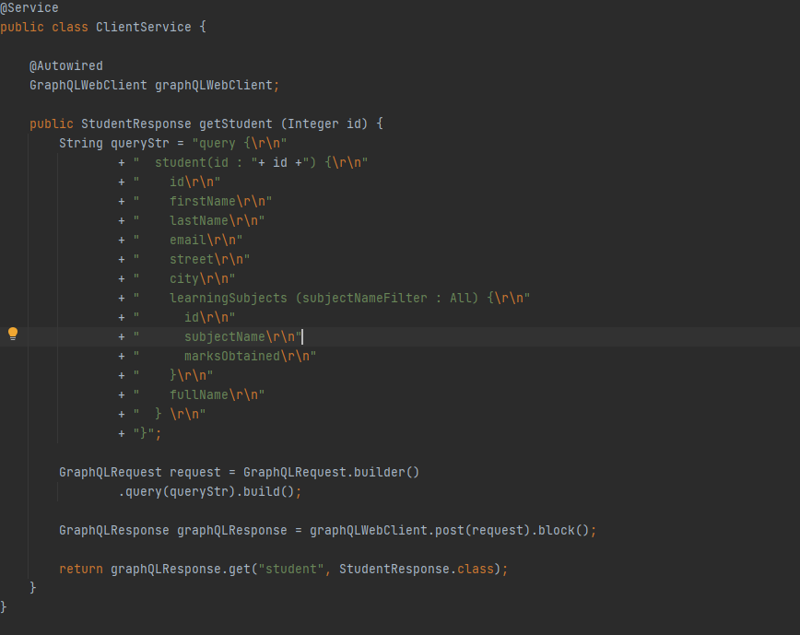
GraphQl client

